Slide 1
SPRINT 2 PRESENTATION
RUN! QUAVER
TEAM 302
MEMBERS: GE BIAN
XIAO KUANG
DATE: 11/20/2017

Slide 2

BACKGROUND
Quaver!
Offer users an online parkour game with two game modes:
Keyboard mode
Voice mode
Important feature:
All players in the same global scene
Pause, resume game under any circumstances
Game playback for TOP3 games in each mode
Notes:
asdfoina;ioensfo;ianewfoibaoeisfn

Slide 3
GOAL & COMPLETED FEATURES FOR SPRINT 2
Rewrite game using p5.js;
Login with Google account;
Implement Voice Control Mode and provide both Keyboard Mode and Voice Mode for logged-in user to select;
Enable pausing game after login;
Semi-update save game status per 5 seconds;
Enable disconnected user resume their last game
Ranking Board for two game modes separately;
Best-Match List for current user;

Slide 4
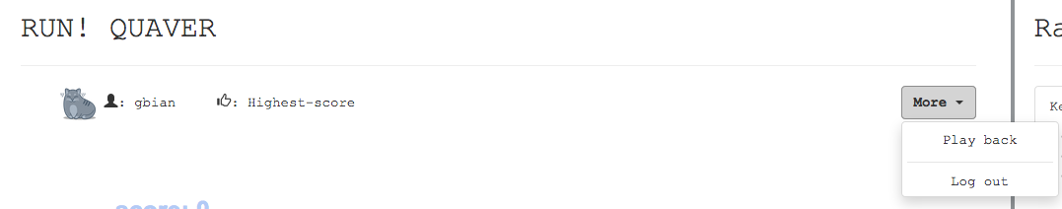
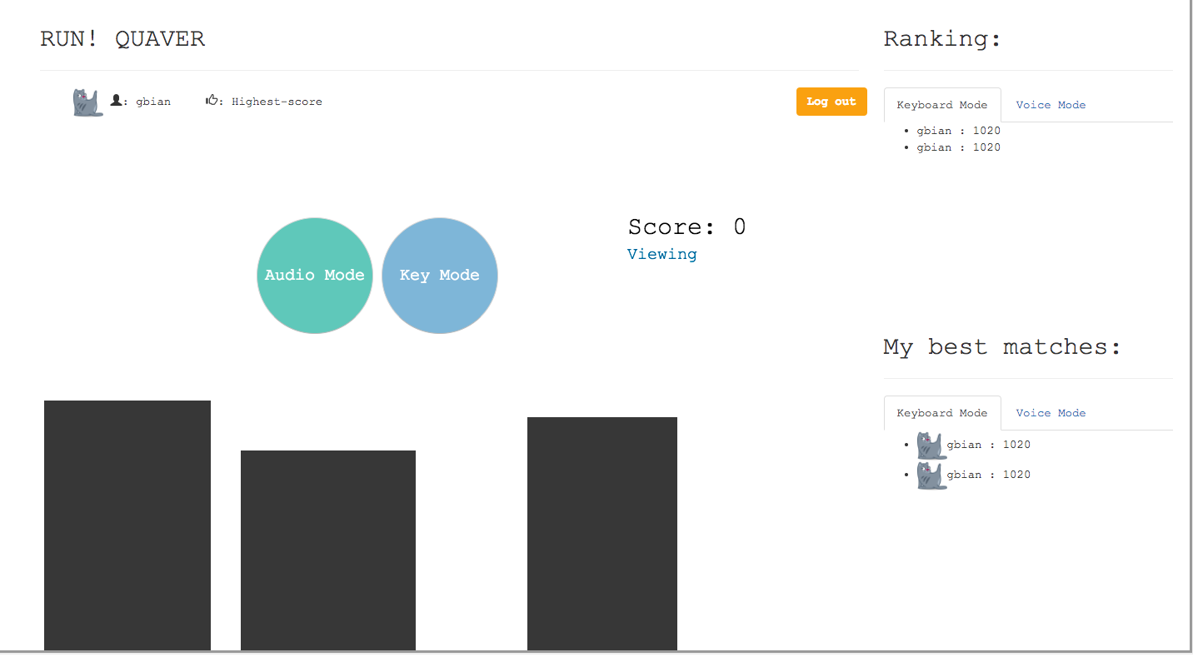
COMPLETED FEATURES
Best matches list for current user

Slide 5
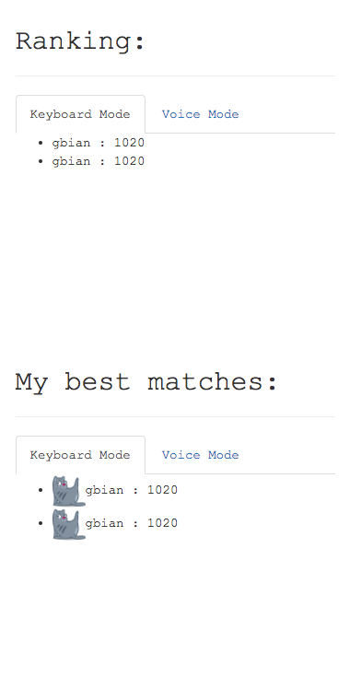
COMPLETED FEATURES
Ranking board for both modes
Best game list for current users

Slide 6
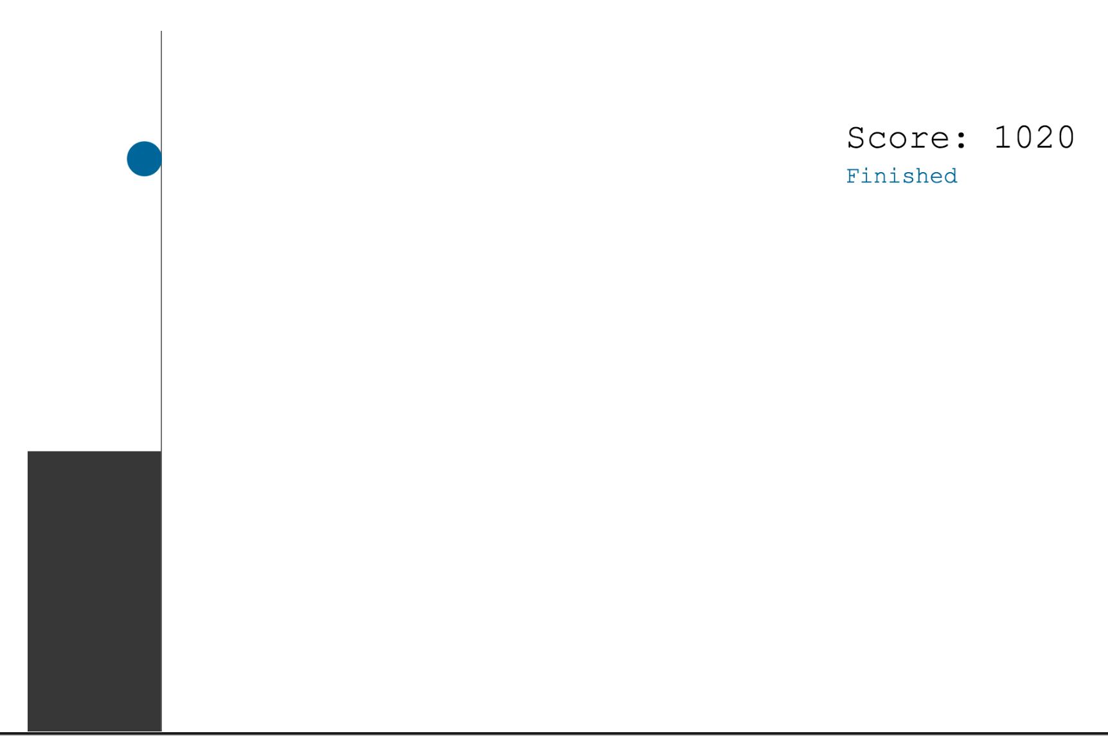

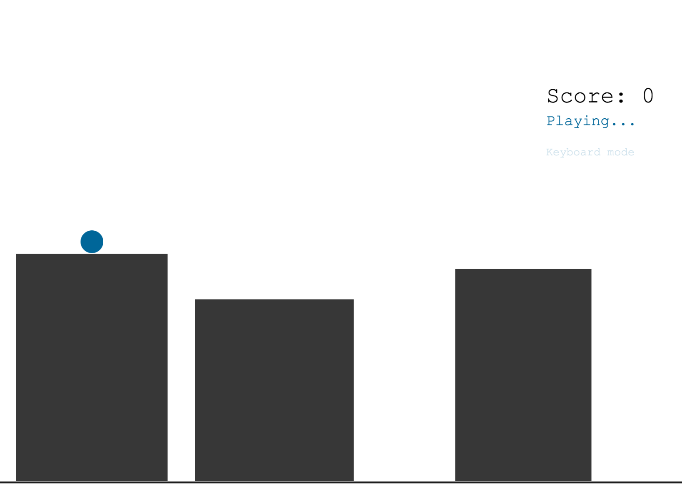
COMPLETED FEATURES
Finished
User Registration without Google account
On pause
Playing
User info board after logging in

Slide 7
ENCOUNTERED PROBLEMS
Rewrite game using p5.js library on canvas
Server-side stream input storage(textfield)
Coordination between elements in static game scene and dynamic state of user (login or logout)

Slide 8
NEXT STEPS
Uncompleshed features from sprint2:
Game play back
game resume for voice mode
Game restart after game over
UIUX improvement
Project deployment
Real-time interaction: Global game scene

